Slide 1

SOFADRICLIMATE app: Smart Climate Solution for Nigerian Crop Farmers
Centre for Sustainable Agricultural Empowerment, Nigeria
Toyin Samuel Olowogbon

Slide 2
AI Systems for Climate Change Predictions and Resilience: Lessons from the SOFADRICLIMATE app in Nigeria

Slide 3
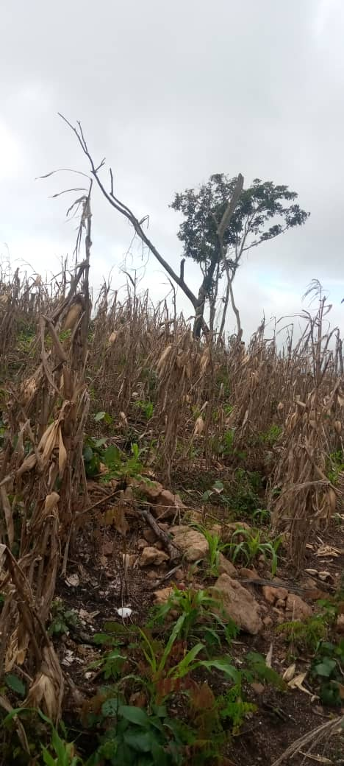
The Problem
Climate change is a risk multiplier for hunger and poverty globally.
About 121 million crop farmers in Nigeria do not have access to reliable climate information and affordable micro-insurance to hedge climate risks.
About 85% of Nigerian crop farmers practice rain-fed agriculture.
An average of N233,000 is lost per maize farmer annually due to erratic rainfall.
Maize farm affected by erratic rainfall pattern in Ekiti State, Nigeria. Photo Credit: SOFADRICLIMATE Team

Slide 4
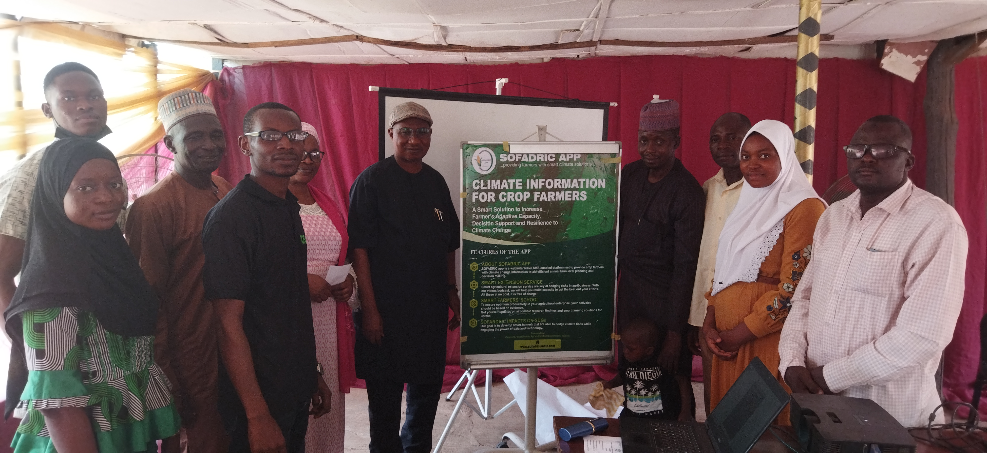
Our take off efforts with farmers

Slide 5
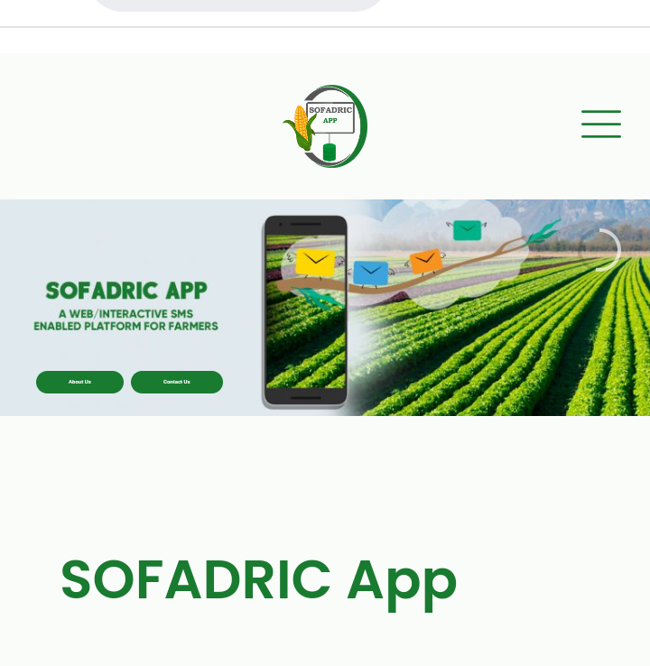
The Solution (www.sofadriclimate.com)
SOFADRICLIMATE is a web-based app bundles data driven, user friendly climate information and weather index micro-insurance to help maize farmers build resilience to climate risks in Nigeria.
Screenshot of the SOFADRIC Web-based app
Photo Credit: SOFADRIC Team

Slide 6




Our approach
Non-technical data driven climate information
Cost-effective Climate information for annual decision support
Weather index micro insurance for farmers
Novel& Robust Contents on best agronomic practices on maize

Slide 7
Lessons from the process
Farmers preferred the web-based app compared to the SMS option based on usage convenience and cost
Developing a web-based app for farmers may not be sufficient-94% of users wanted monthly SMS reminders.
Poor digital literacy as third party onboarded some users
Farmers wanted targeted support to onboard the insurance platform

Slide 8
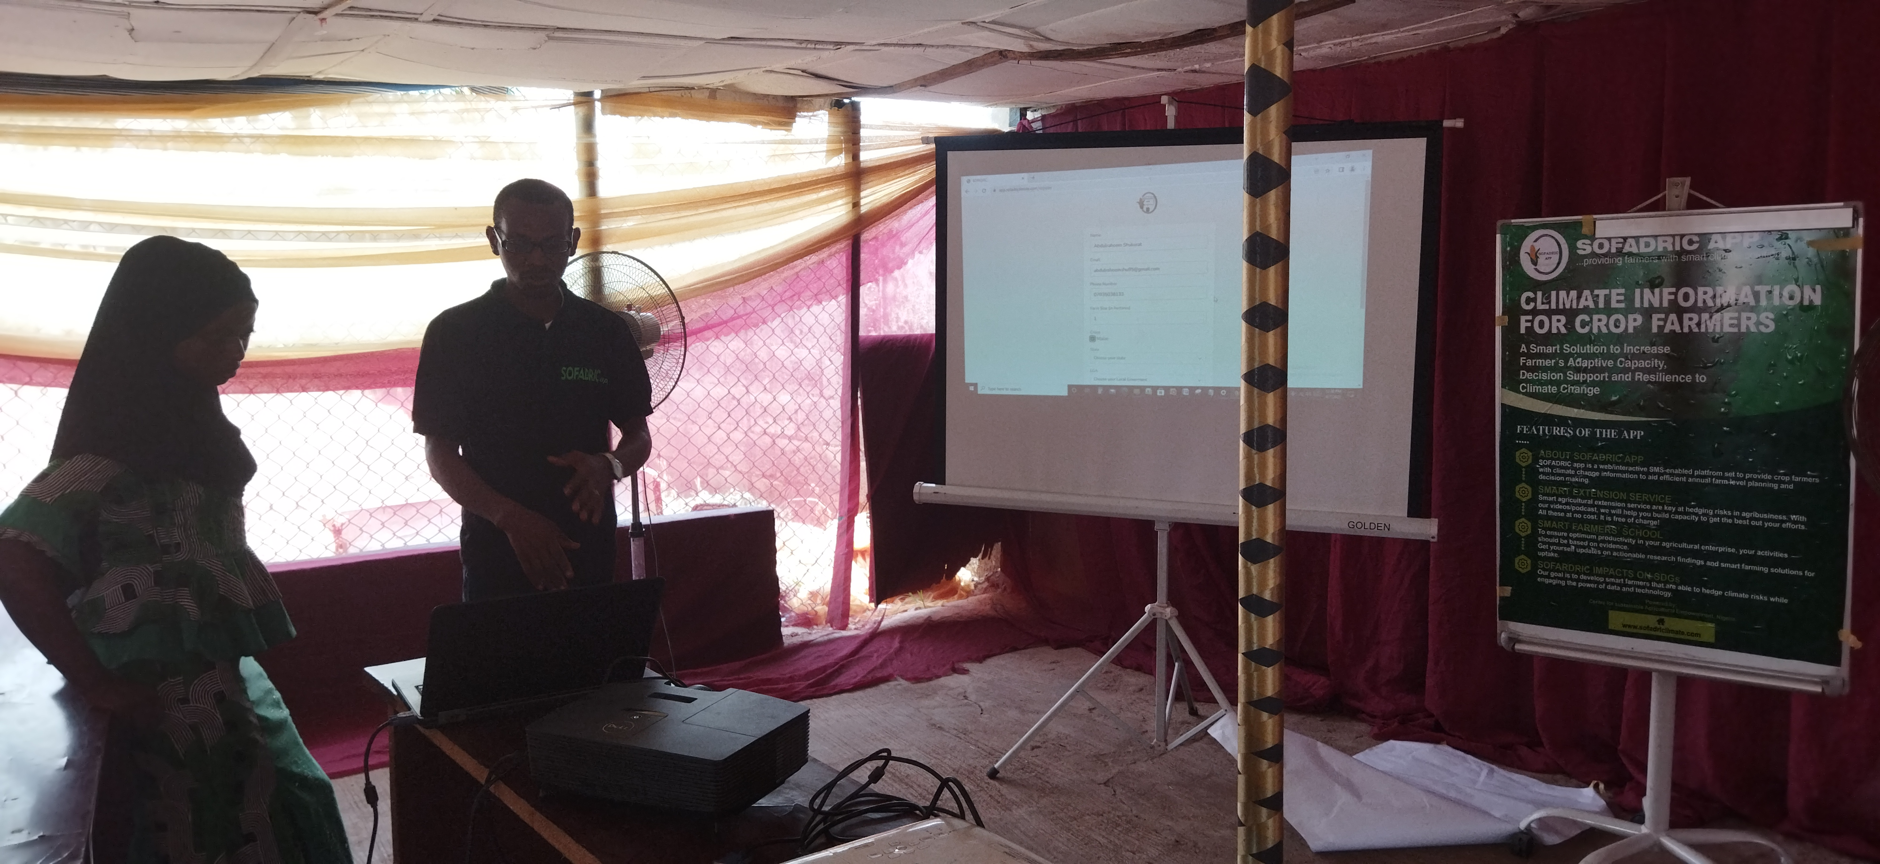
Next Actions
Further adaptation
Embedding awareness and training on SOFADRICLIMATE app
Integrating monthly SMS reminders
Integrating a token annual subscription to onboard intentional farmers
Integrating flood warning reports
Build Support Systems
Advance evidence to influence decision-makers, researchers and network service providers in developing support systems for this innovation.

Slide 9
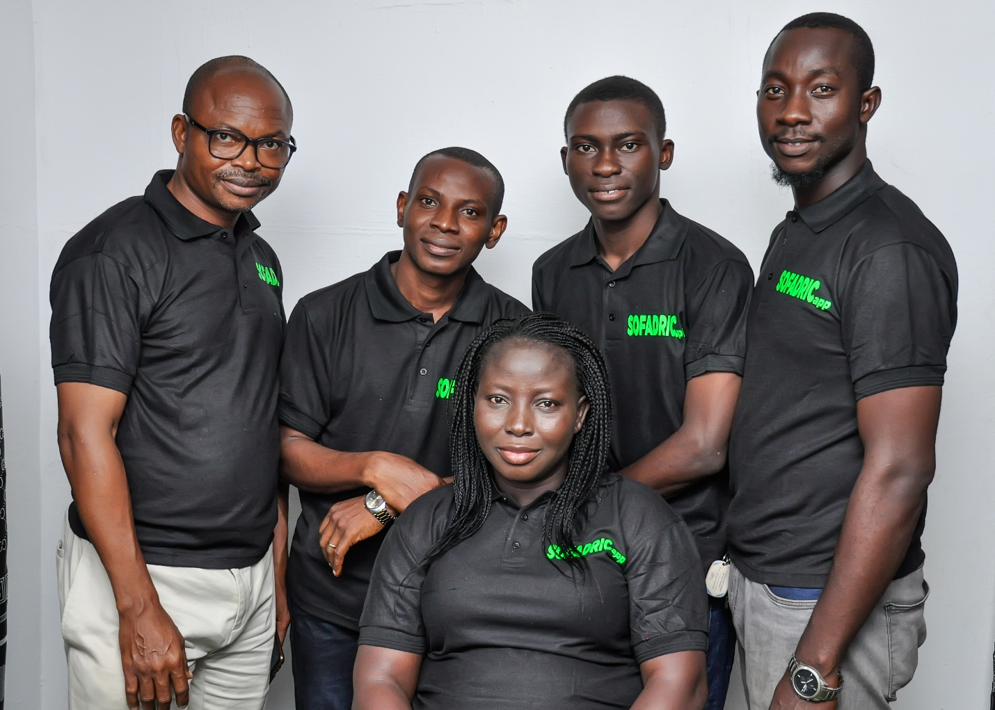
The Faces Behind SOFADRICLIMATE App

Slide 10

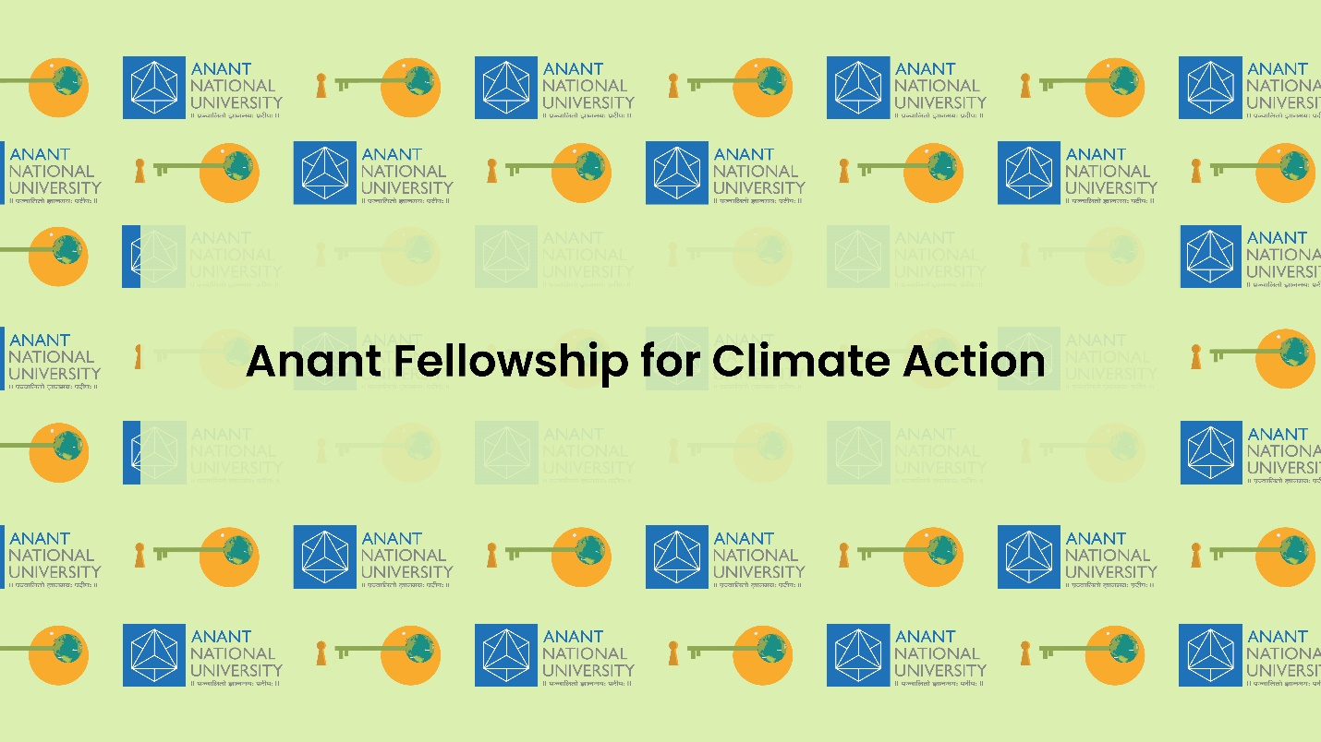







Our Partners

Slide 11
Let’s do it together!
Toyin Samuel Olowogbon, PhD
Agricultural Economist
Centre for Sustainable Agricultural Empowerment (CSAE), Nigeria.
Website: www.csaempowerment.com
Mobile: +2348063116647: email: olowogbonsamuel@gmail.com/solowogbon@sofadriclimate.com

Slide 12


